Slide 1


Chef and Docker
CMPE 283 Spring 2015
Team 1:
Neeraja Kukday
Anusha Ravikumar
Harshad Kulkarni
Mahesh Dhamgunde

Slide 2
Project Group Members Contribution
Docker Demo | Harshad, Mahesh
Chef Demo | Neeraja, Anusha
Docker & Chef Research | Neeraja, Anusha, Harshad, Mahesh

Slide 3
Presentation Outline
Business Problem
Solution to Business Problem
Docker
Chef
Demo Chef
Demo Docker

Slide 4
Business Problems
Scalability
Service Isolation
Configuration Management

Slide 5
Docker
Similar to Linux Containers
Solomon Hykes - Standard shipping containers that can be used to ship any product
DevOps Engineers - Need to only know how much to ship and where to ship
Use case: Ebay

Slide 6
CHEF
Used for configuration management
Write scripts for configuration, updation, deployment on the server
Used for continuous integration. Automatically deploying new builds

Slide 7
Nightmares working on local dev env
Too many manual tasks required in setup
Performance issue/machine is too slow
Inconsistency with production environment
How To solve?
Environment on Demand
Automated Configuration Management
Faster Deployment cycle
Better performance

Slide 8
Introduction to Docker
An open source software used to perform various operations with Linux containers.
Helps in creating environment on demand.
Containers are lightweight(Typical laptops can run around 10-100 containers)
Helps to isolate the processes.
Does not require a separate OS, uses Kernel’s functionality and uses separate namespaces.

Slide 9
Why Docker
Rapid Application Deployment
Portability across machines
Version control and component reuse
Sharing images with help of Docker Registry
Simplified maintenance

Slide 10
Containers Vs VM
You can create or destroy containers quickly and easily.
Containers are lightweight, therefore, more containers than virtual machines can run simultaneously on a host machine.
Containers share resources efficiently. Virtual machines are isolated.
Disadvantage: Virtual machines can be migrated while still executing, however containers cannot be migrated while executing and must be stopped before moving from host machine to host machine.
Containers do not replace virtual machines for all use cases. Careful evaluation is still required to determine what is best for your application.

Slide 11
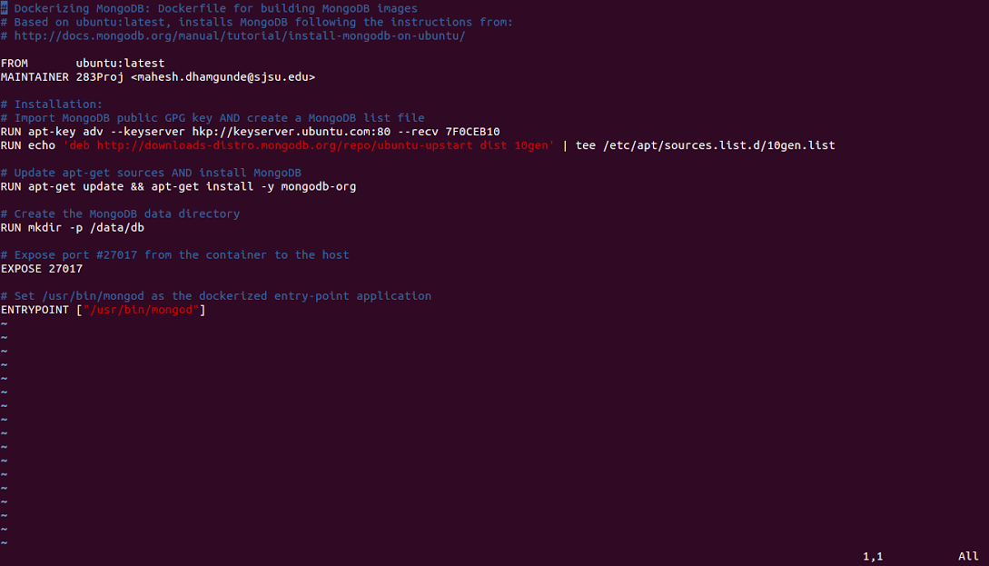
Dockerfile
Dockerfile Example: MongoDB

Slide 12
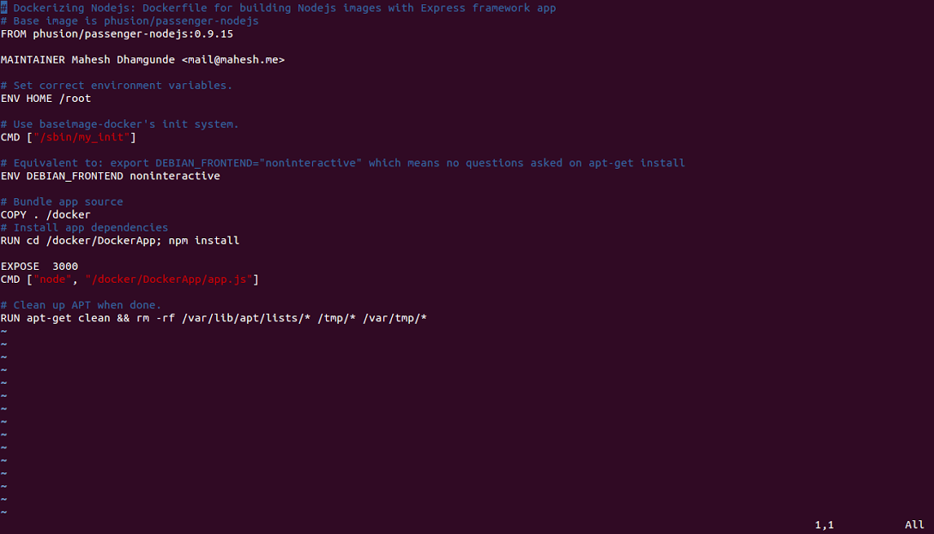
Dockerfile Example: Node.js

Slide 13
Docker Demo
Docker Images
Dockerfile and building and running Docker
Isolation of services in Docker containers : MongoDB and Node.js

Slide 14
Introduction to Chef
Configuration Management tool (ruby)
Environment management
Turns infrastructure into code-->easy to deploy servers and applications to any physical, virtual, or cloud location
Automate: configuration, deployment, and manage infrastructure.
Notes:
: what it should do and how it should be maintained

Slide 15
Chef Terminologies
Resource: piece of infrastructure and its desired state
Recipe: collection of resources with desired configuration
Cookbooks: collection of recipes; defining a scenario
Chef-client: installed on every node that is under management by Chef. Executes recipes pulled from chef server.
Chef Server: all infrastructure information, manages nodes
Workstation: local dev env.; 1+ workstations are configured to allow users to create, modify, and maintain cookbooks.
Knife command line tool to interact with the server.
Cookbooks are uploaded to the Chef server from the workstation.

Slide 16
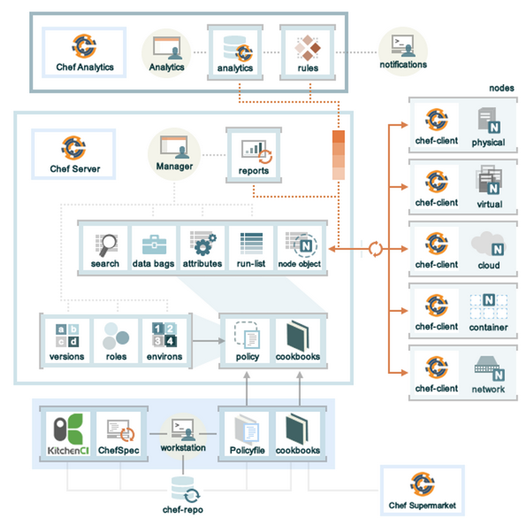
Components of Chef

Slide 17
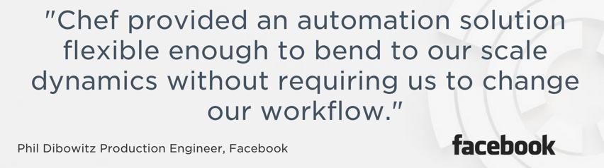
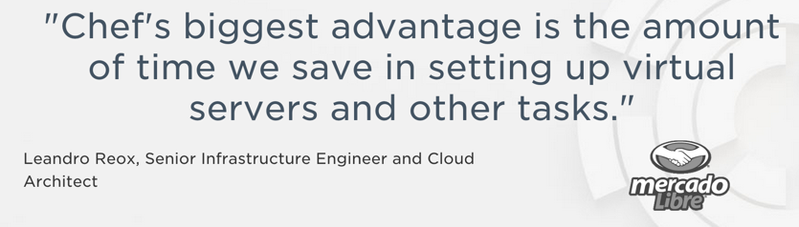
Why Use Chef?
Improves Efficiency:
Reduces manual tasks required in setup
Reduces inconsistency
Idempotent
Reduces documentation
Speed and automation

Slide 18
Disadvantages of Chef
Ties users to Ruby
Doesn’t support push:
systems must check with the Chef server for configuration changes to take effect.
immediate implementation of changes is not possible
Required dependencies have incompatible versions.
Notes:
knife has conflicting version with gem on json

Slide 19
Chef Demo
Anusha- Chef basic: resources and recipes
Neeraja - Chef and docker

Slide 20
Thank you!

Slide 21
References
https://www.chef.io/chef/
http://docs.chef.io/chef_overview.html
http://www.slideshare.net/sanjeev-sharma/chef-for-dev-ops-an-introduction
http://www.slideshare.net/dstine4/jenkins-and-chef-infrastructure-ci-and-automated-deployment
http://www.scriptrock.com/articles/salt-vs-chef

